Slide 2
Tool & Systems
List of Tools
Allsec - Payroll Website
Vidal Health - Medical Insurance
ESIC - Employee State Insurance Corp
MYTE - My time & Expenses
Online PF Transfer - Epfo Website
Service – Now - Service Online
Copyright © 2017 Accenture All rights reserved.
Copyright © 2017 Accenture All rights reserved.

Slide 3
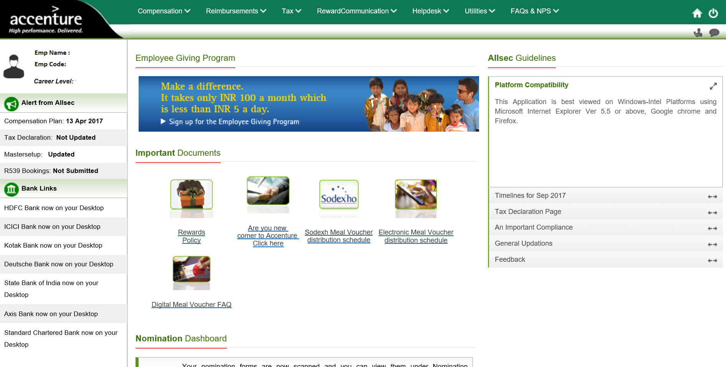
Allsec: Employee Self-Service Payroll Home Page
Copyright © 2017 Accenture All rights reserved.

Slide 4







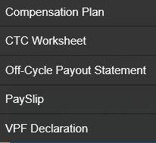
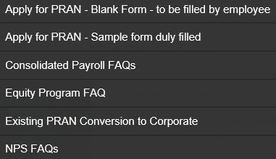
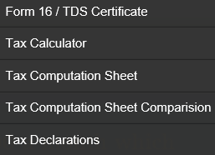

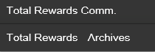
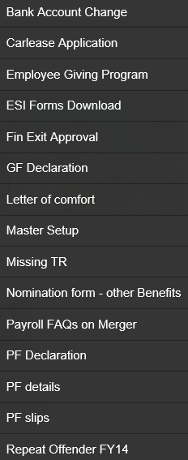
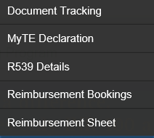
Allsec: Employee Self-Service Payroll Services: Menu & Sub-Menu
Copyright © 2017 Accenture All rights reserved.

Slide 5
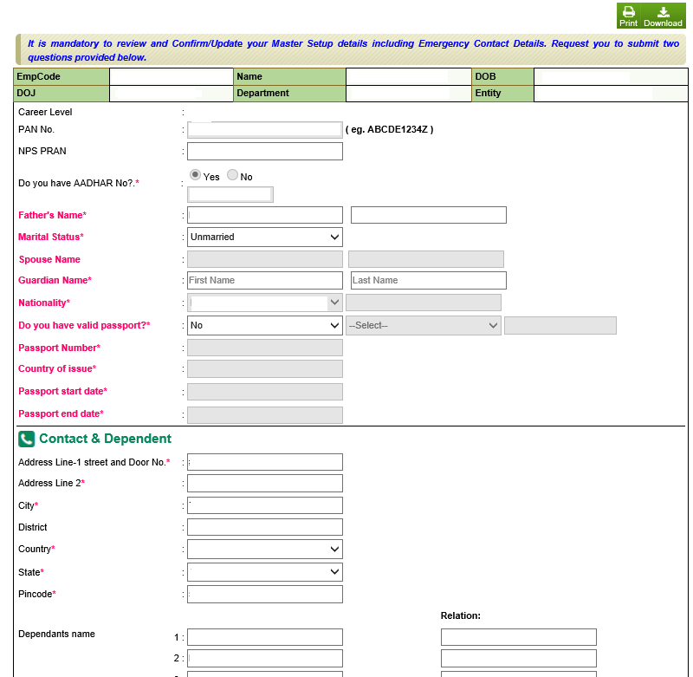
Allsec: Employee Self-Service Payroll First Time Login – Master Set-up
Copyright © 2017 Accenture All rights reserved.

Slide 6
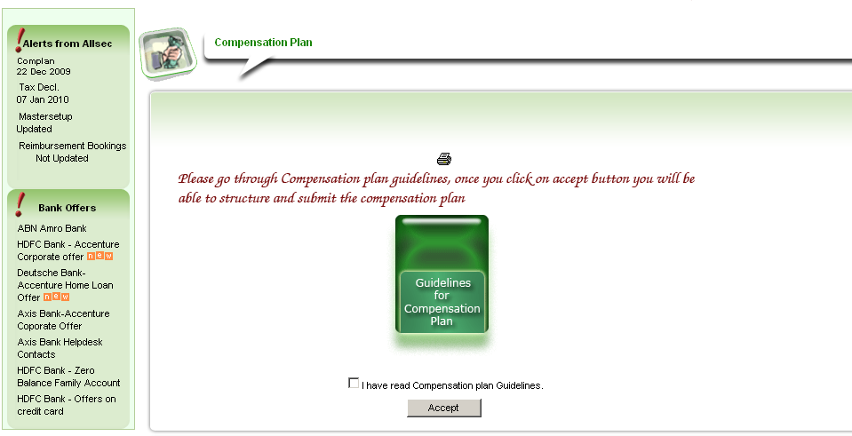
Allsec: Employee Self-Service Payroll Compensation Guidelines
Copyright © 2017 Accenture All rights reserved.

Slide 7
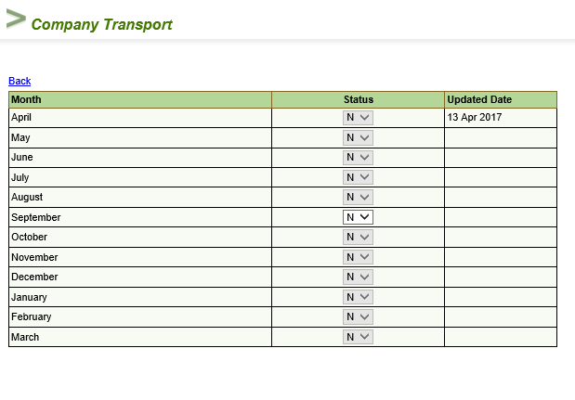
Allsec: Employee Self-Service Payroll Comp Plan Structure - Transportation
Copyright © 2017 Accenture All rights reserved.

Slide 8
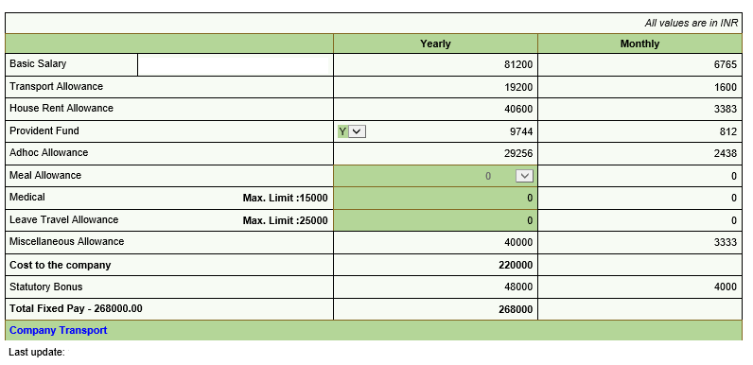

Allsec: Employee Self-Service Payroll Comp Plan Structure –Fixed Pay Employee
Copyright © 2017 Accenture All rights reserved.

Slide 9
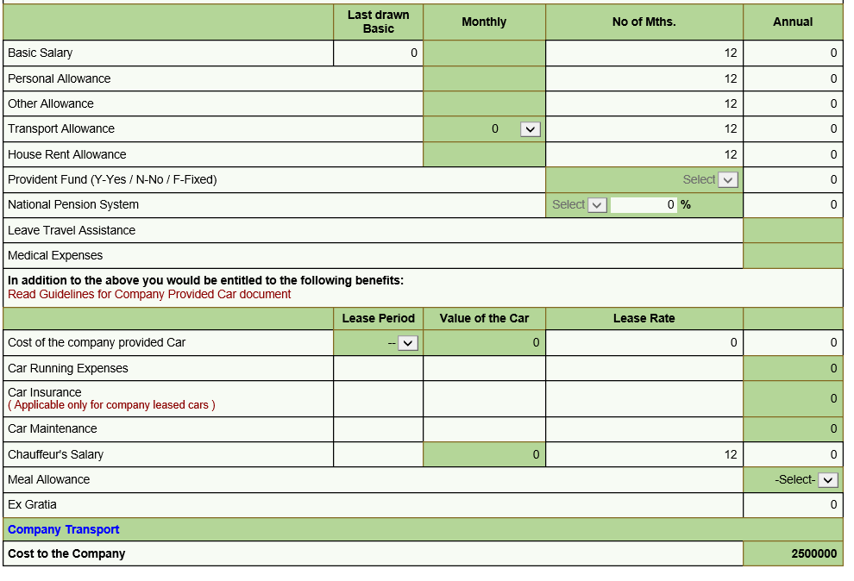
Allsec: Employee Self-Service Payroll Comp Plan Structure – Flexi Pay Employee
Copyright © 2017 Accenture All rights reserved.

Slide 10
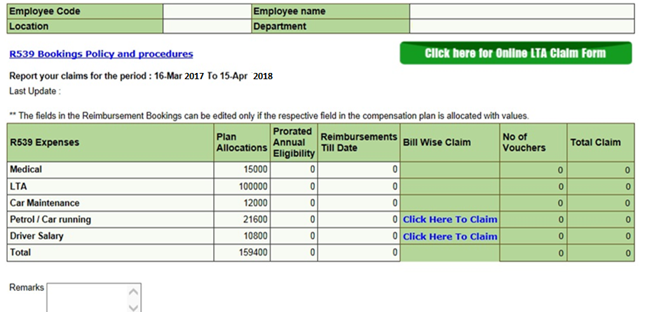
Allsec: Employee Self-Service Payroll R539 Reimbursement - Booking
Claim booked by 10th of every month and original bills to be received by
s To be finance on or before 12th
Copyright © 2017 Accenture All rights reserved.

Slide 11
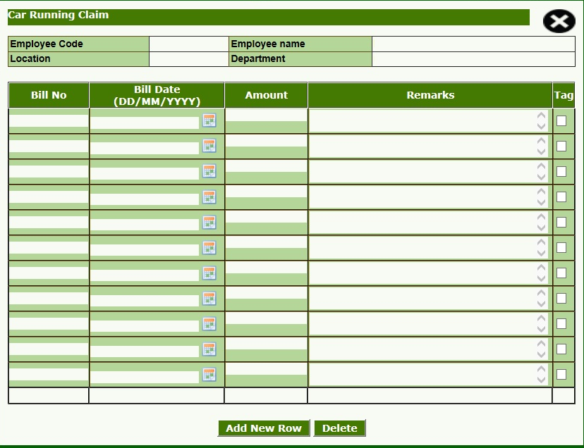
Allsec: Employee Self-Service Payroll Car Running Claim
Copyright © 2017 Accenture All rights reserved.

Slide 12
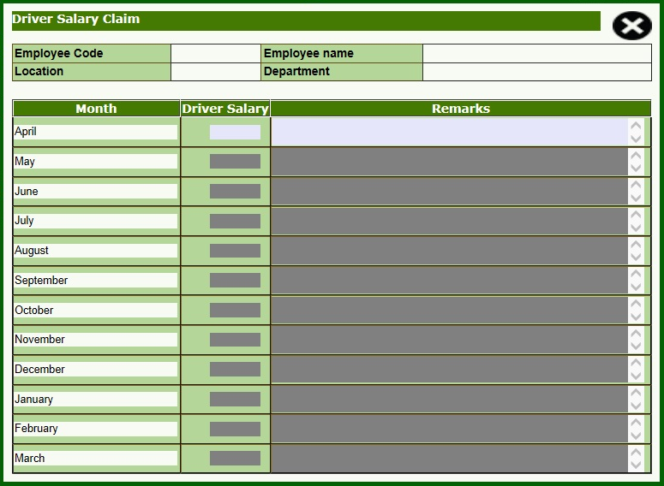
Allsec: Employee Self-Service Payroll Driver Salary Claim
Copyright © 2017 Accenture All rights reserved.

Slide 13
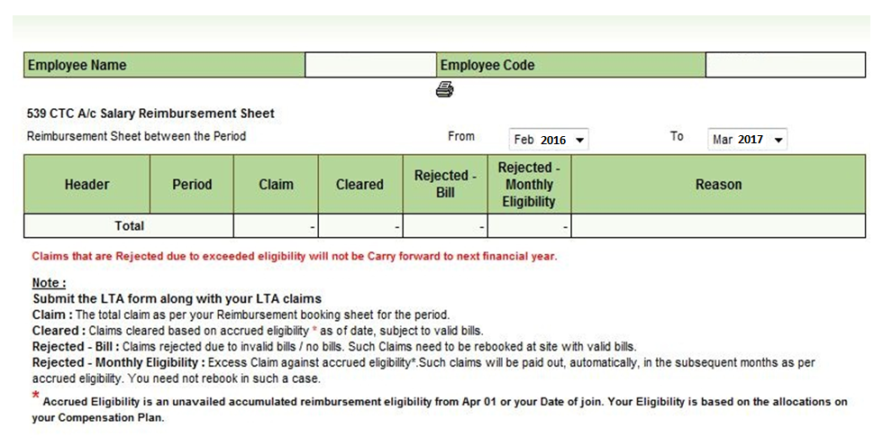
Allsec: Employee Self-Service Payroll R539 Reimbursement – Pmt Sheet
Copyright © 2017 Accenture All rights reserved.
Copyright © 2017 Accenture All rights reserved.

Slide 14
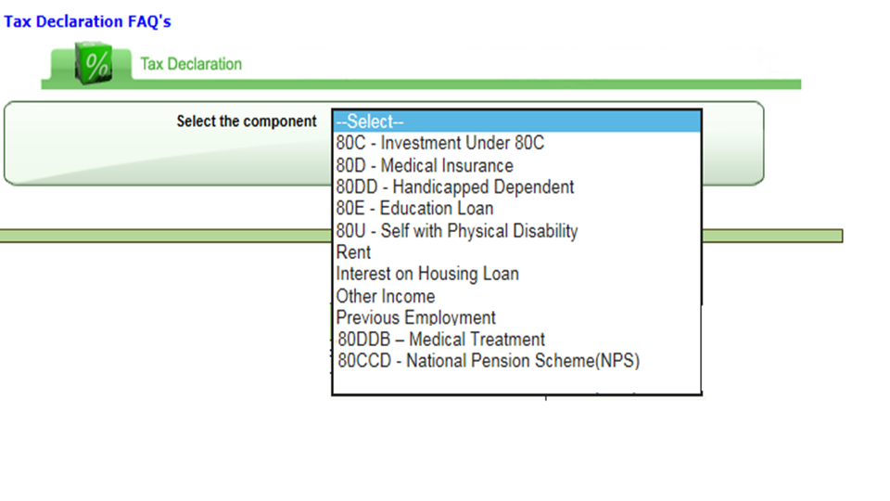
Allsec: Employee Self-Service Payroll Declaration Sheet
Copyright © 2017 Accenture All rights reserved.

Slide 15
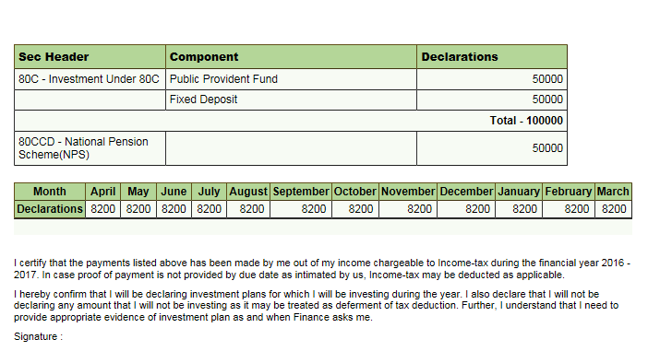
Allsec: Employee Self-Service Payroll Declaration Sheet
Copyright © 2017 Accenture All rights reserved.

Slide 16



Medical Insurance – Vidal Health Highlights
Vidal Health TPA is a third party Vendor for Medical Insurance.
URL: https://tips.vidalhealthtpa.com/vidalhealth/index.htm
Medi claim policy cycle: Oct 17th - Oct 16th
Policy details
Policy 1-3-4 (Self, Spouse & Children) Policy 2 &5 (Parents/In laws/Additional Children)
Copyright © 2017 Accenture All rights reserved.

Slide 17
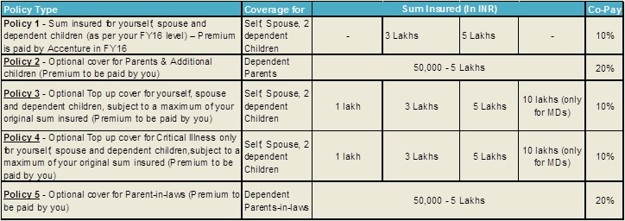
Medical Insurance –Vidal Health Group Medi claim coverage detail
Copyright © 2017 Accenture All rights reserved.

Slide 18
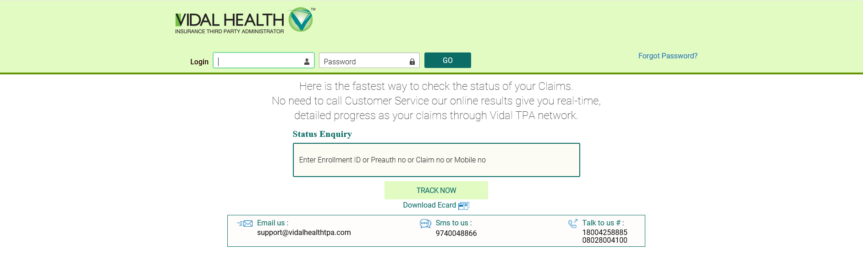
Medical Insurance – Vidal Health Online enrollment guide
User name: 8 Digit SAP Number (Employee Code)
Password : Date of birth (DOB) followed by Date of joining (DOJ), without any spaces, in DDMMYYYY format.
Note: On your first login, system will prompt to you to change your password
Copyright © 2017 Accenture All rights reserved.

Slide 19
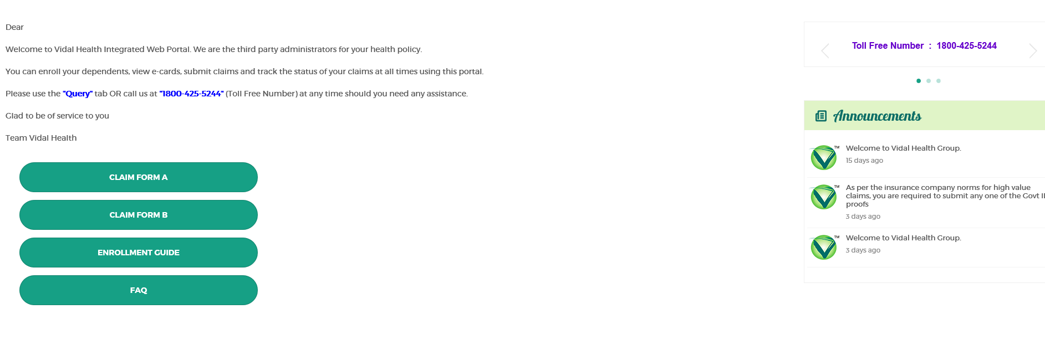
Medical Insurance - Vidal Health Home Page
Copyright © 2017 Accenture All rights reserved.

Slide 20
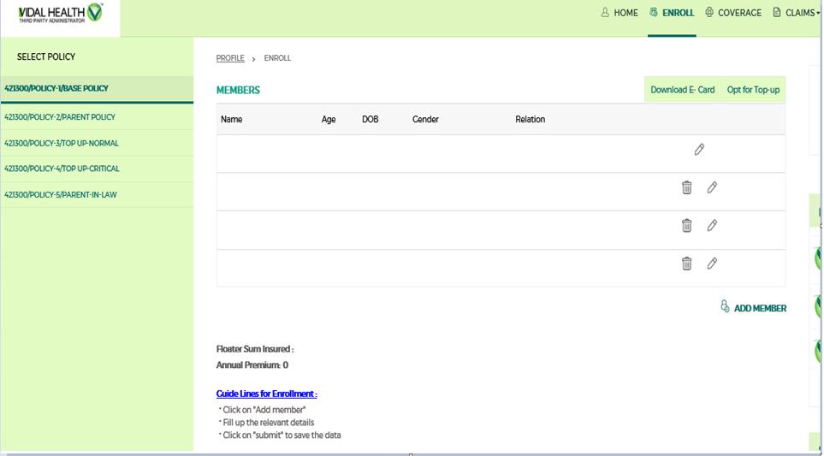
Medical Insurance - Vidal Health Online Enrolment screen
Copyright © 2017 Accenture All rights reserved.

Slide 21



Medical Insurance - Vidal Health Policy Procedure
Cashless Hospitalization
Claims Processing
Policy Coverage
Co-Payment by Employees
Policy 1, 3 & 4 - 10%
Policy 2 & 5 - 20%
Note : - Queries related to Vidal Health can be raised by using the option “Online Query Page”
Contact VIDAL HEALTH TPA @ Toll-Free numbers : 1800 425 5244
Personal Accident Insurance : 3 X the annual fixed Compensation
Group Term Life Insurance : Level 5, 6 & 7 :- 4 X the annual fixed Compensation
Levels below Level 8 :- 1 X the annual fixed Compensation (subject to a minimum of Rs. 5 lakhs)
Copyright © 2017 Accenture All rights reserved.

Slide 22
Employees’ State Insurance Corporation
WHAT IS ESIC ? Multidimensional social system Provides Socio- economic protection to worker population & dependents Insures employee from day one Entitled to variety of benefits in times of physical distress due to sickness, temporary or permanent disablement etc. | ESI BENEFITS ? Medical Benefit Sickness Benefit (SB) Maternity Benefit (MB) Disablement Benefit Dependents' Benefit (DB) Funeral Expenses
CONTRIBUTION Comprises of Employee’s & Employer’s contribution Employee’s contribution - 1.75% of the wages Employer’s contribution - 4.75% of the wages | CONTRIBUTION AND BENEFIT Two contribution periods each of six months duration Benefits periods are also of six months duration as below
Copyright © 2017 Accenture All rights reserved.

Slide 23
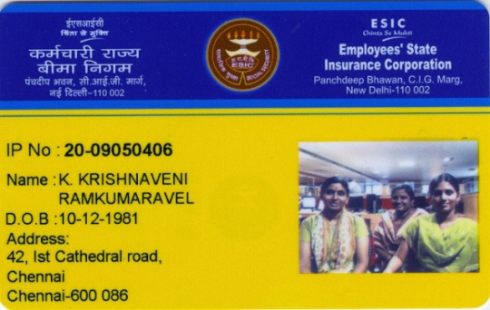
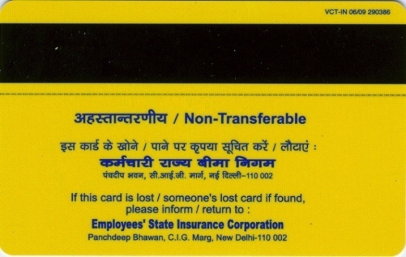
Pehchan Card
Procedure for collecting Pehchan card
Employee has to visit his nearest ESI office with his family members- spouse, children and dependent parents and carry the TIC (Temporary Identity Certificate) issued by the employer.
The concerned ESI authorities will take photographs of the family and update the details available in TIC in their records.
After a month, the Pehchan card will be dispatched to the employees’ residential address available in the ESI website.
Two identical cards shall be issued to the insured person and his family, which will enable them to avail treatment anywhere in the country
The Pehchan Card is valid for lifetime across all ESIC hospitals and dispensaries in the country subject to certain conditions. A unique number will be assigned to each member so that he can continue using the Card even in case of a change in job.
One card is with Insured Person and the other with the family which would enable the family to avail treatment even when they are away at different locations. The card will have the photographs of all the family members and their biometric details.
•Insurance Number
•Name of the Insured Person
•Date of Birth
•Address
•Family photograph
•Micro line
•UV Text
•Magnetic Stripe
•Micro Textx
•Statutory Instructions
•Hologram
Copyright © 2017 Accenture All rights reserved.

Slide 24

MYTE : My Time & Expenses
Important Points
Points to be Remembered
Time Report is a fortnightly record of time and expenses of each employee.
Time report is mandatory for processing salary
To be submitted 2- 3 days before the fortnight ends
All employees are responsible for submitting timely, accurate and complete time and expense reports, in accordance with Accenture policies
Employees are responsible for all time and expenses reported, even if the time report is completed on their behalf by someone else, and they must submit the required documentation.
Compliance with policies is an issue of professionalism and integrity. It is each individual's responsibility to respond promptly to any questions raised about his/ her time or expense report and its contents. Violation of these policies is subject to disciplinary action, including, potentially, termination.
Copyright © 2017 Accenture All rights reserved.

Slide 25

MYTE : My Time & Expenses
Types of Expenses
Accenture reimburses employees for costs incurred and paid when performing business on behalf of the Company. Expenses should be recorded and reimbursed only when incurred, and should be reported in accordance with policies.
There are two types of expense categories as described below:
Expense Reporting
Allowances
Reimbursable Expenses
Copyright © 2017 Accenture All rights reserved.
Copyright © 2017 Accenture All rights reserved.

Slide 26
MYTE : My Time & Expenses
Types of Expenses
Allowances
Per diems and meal allowances, which are provided when a business situation meets a specific qualifying criteria
Reimbursable Expenses
539 expenses, which are actual expenses incurred by the employee with appropriate documents supporting, wherever feasible. Tax would be deducted on expenses without appropriate proofs.
Country controllers or service centers audit and check the expense documentation for the following:
Original, itemized receipts submitted
Confirmation of payment indicated
Compliance with laws
Receipt amounts match expenses reported
Copyright © 2017 Accenture All rights reserved.

Slide 27
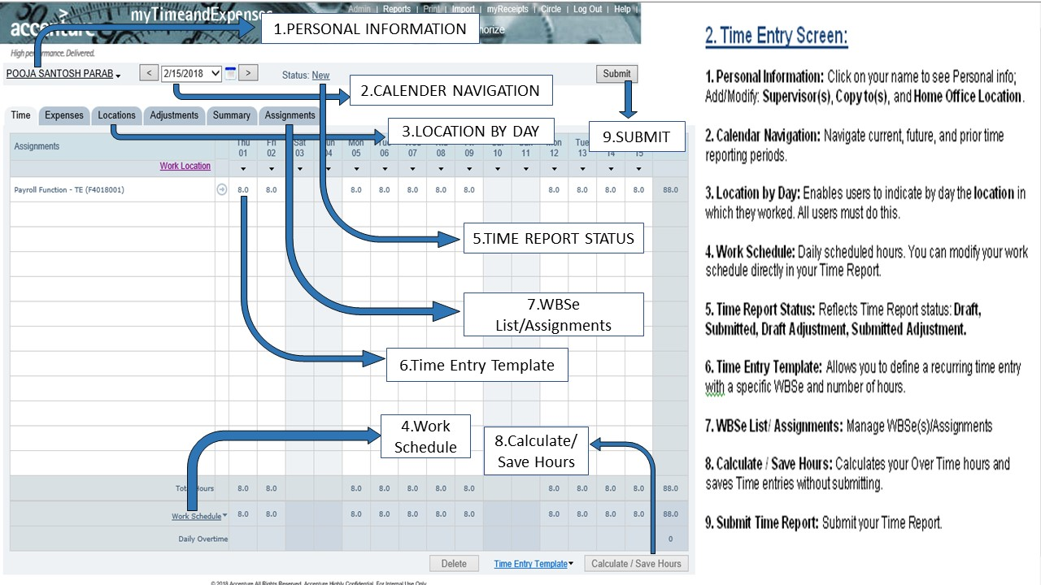
MYTE : My Time & Expenses
Login Procedure
Copyright © 2017 Accenture All rights reserved.

Slide 28
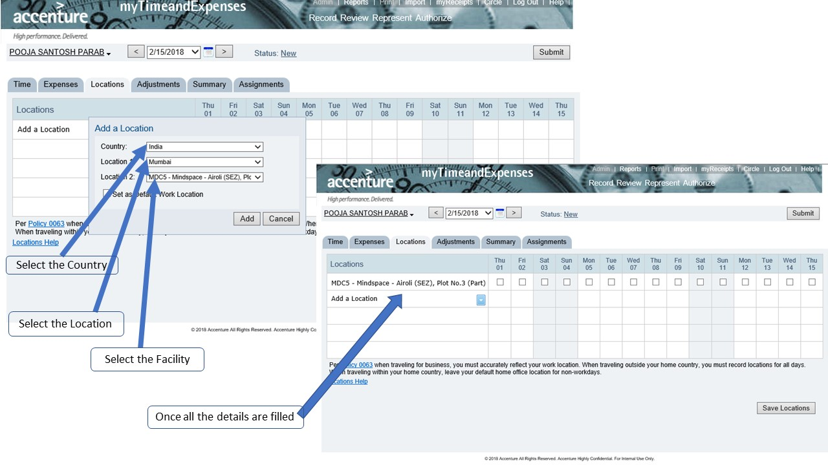
MYTE : My Time & Expenses
Location input
Copyright © 2017 Accenture All rights reserved.

Slide 29
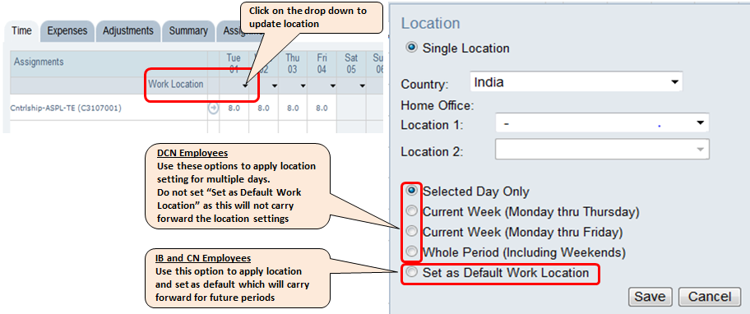
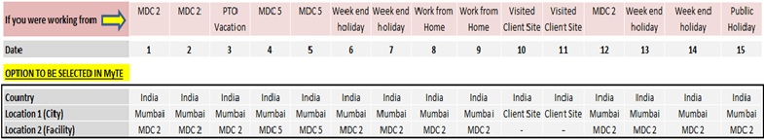
MYTE : My Time & Expenses
Mandatory Location input to submit time report
DCN employees (Delivery Centers for Technology in India, Accenture Operations and India Corporate Function employees) are required to mandatorily input the location data every fortnight
IB and CN employees will have an option to set a default work location which will be carried forward for future time periods
Example: A sample scenario for a fortnight for an employee whose home location is MDC 2 is given below:
Copyright © 2017 Accenture All rights reserved.

Slide 30
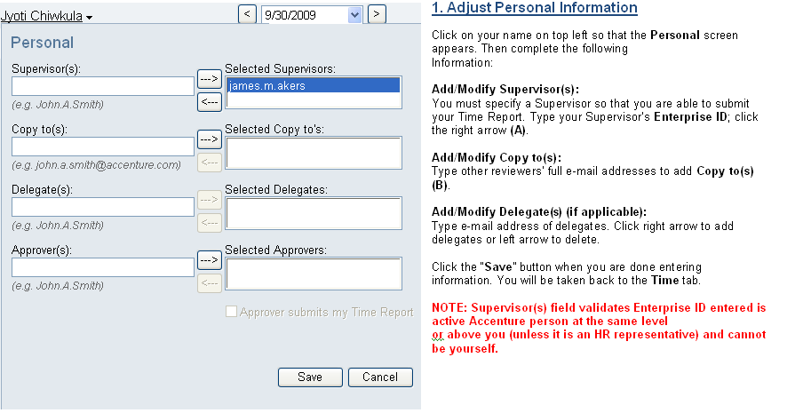
MYTE : My Time & Expenses
Personal Information
Copyright © 2017 Accenture All rights reserved.

Slide 31
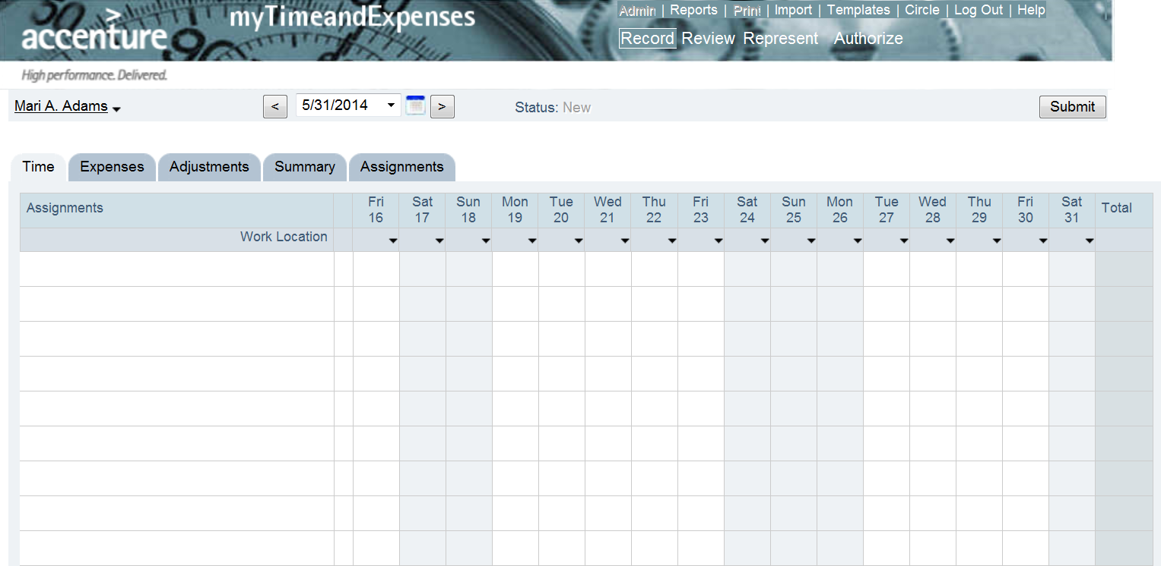
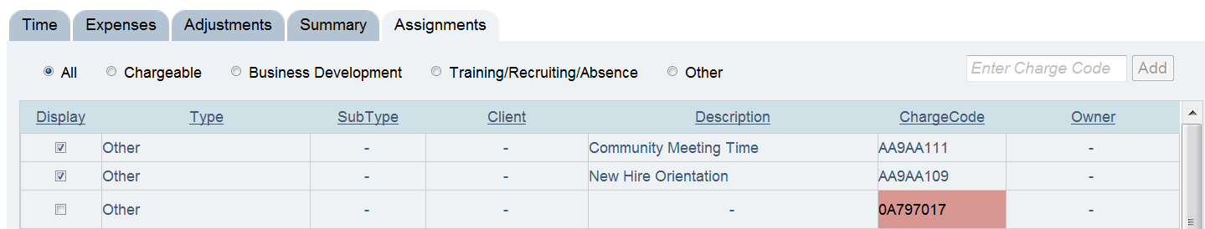
MYTE : My Time & Expenses
Manage Your Assignments : WBSe
Copyright © 2017 Accenture All rights reserved.

Slide 32
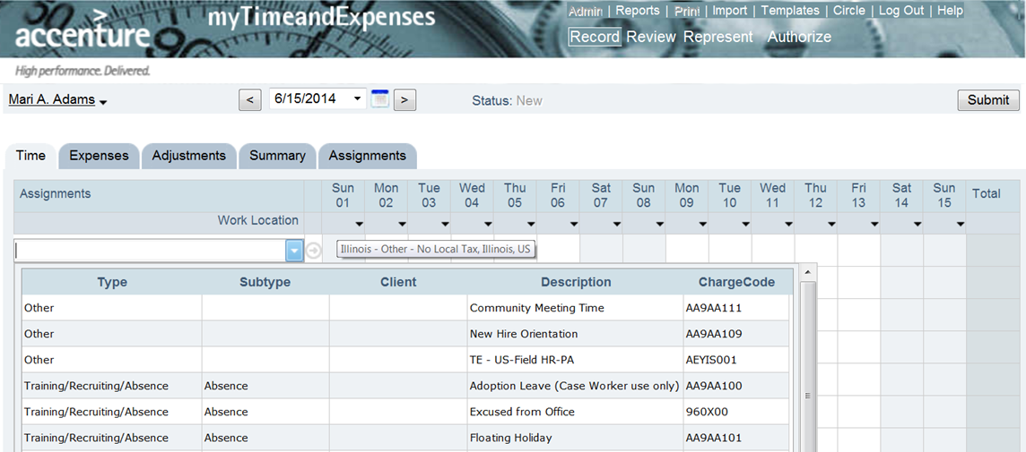
MYTE : My Time & Expenses
Enter Your Hours
9 9 9 9 9
Note: Entries are lost if you do not save prior to logging out.
Copyright © 2017 Accenture All rights reserved.

Slide 33
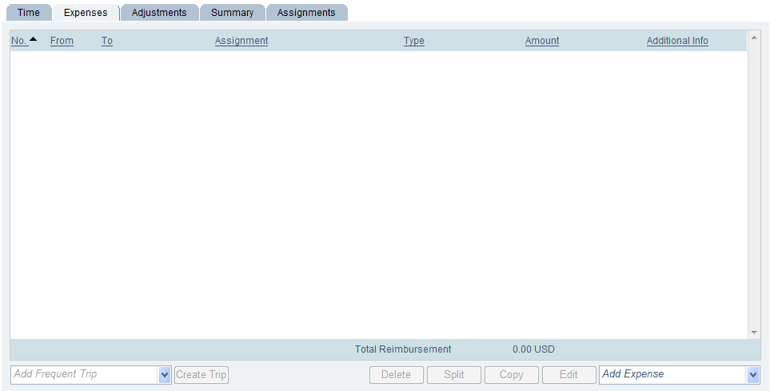
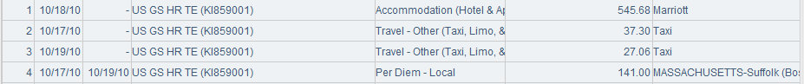
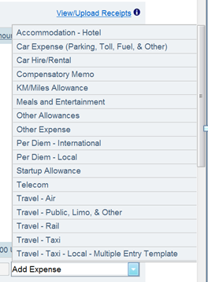
MYTE : My Time & Expenses
Enter Your Expenses
Copyright © 2017 Accenture All rights reserved.

Slide 34
How to claim relocation expenses in MyTE
Relocation Expenses can be claimed through https://myte.accenture.com –under - > Add Expense -> Other Expense > Relocation Expense.
Relocation expenses for Transport and Brokerage should be claimed in one single line item. You should however mention in ‘Description’ Field the breakup of expense claims. For e.g. If you have claimed 20000 towards transport & Brokerage, you should clarify that 10,000 is for Transport and 10000 for Brokerage etc.
Accommodation and Per diems need to claimed in separate lines items in MyTE and should not be included with any other claim.
For new joiners claiming relocation expenses, the date of relocation should be not be less than your Date of Joining. If your relocation happened before your date of joining, you should still select the DOJ as ‘From’ date in MyTE.
Once you have successfully claimed the expense and your time report has been submitted,
Take a print out of the MyTE expense page,
Attach the original relocation bills, challans etc. (Details in next slide)
It advisable to retain photocopy of receipts for your reference.
Put the original receipts in the expense envelope available at Accenture mailroom across all Accenture facilities.
Drop the envelope in MyTE drop box which is available in all Accenture facilities.
Expense will be reimbursed once envelope reaches the MyTE team (which may take 5 to 7 working days).
You can check status of envelope by logging into Allsec - https://smartpay.allsectech.com/accenturelogin and GO TO -> Reimbursements -> Document tracking, under “MYTE” heading -> ‘Period’ column (If the period in which expenses are claimed is not reflecting in the below list, the envelope is yet to reach the team)
Copyright © 2017 Accenture All rights reserved.

Slide 35
Important points for Claiming Relocation Expenses
Eligibility (monetary limit and types of claimable expenses) to be confirmed by respective People Advisor/Relocation scheduler.
Employees should not claim relocation expenses more than their eligibility.
Original supporting (bills) along with the copy of offer letter which mentions claiming of relocation expenses.
WBSe for Relocation expenses should be taken from People Advisor/Relocation scheduler.
Relocation expenses should be claimed within 3 months from the DOJ/date of relocation.
Please note there is a limit on the amount that you can claim under relocation WBSe. You can contact your People Advisor or scheduler for getting the limits reinstated in case of reversals/rejections of claims.
Proof required to avoid rejection of Relocation Expense:
For a Transportation (relocation)expense to be cleared, one needs to include
LR (Lorry Receipt) copy/Challan
Packaging slip (details of goods transported),
Payment receipt.
Original brokerage bills.
Original Rail (IRCTC print out will suffice)/Road/Air bills are needed (for Air travel, boarding pass is required).
Original Itemized accommodation bill.
Original bills are needed for any other expenses.
Please Note – If the claim is made without the requirements mentioned in Point 7, the same will be rejected.
Copyright © 2017 Accenture All rights reserved.

Slide 36
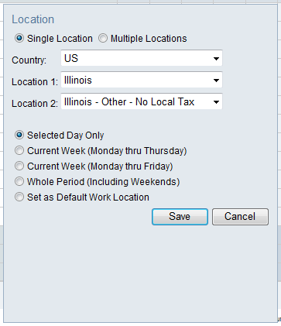
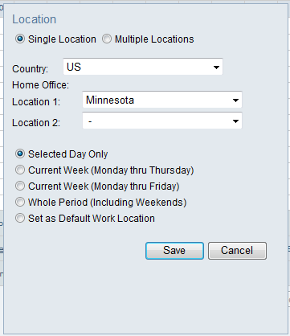
MYTE : My Time & Expenses
Manage your work location
Set your Default
Set your Default
Copyright © 2017 Accenture All rights reserved.

Slide 37
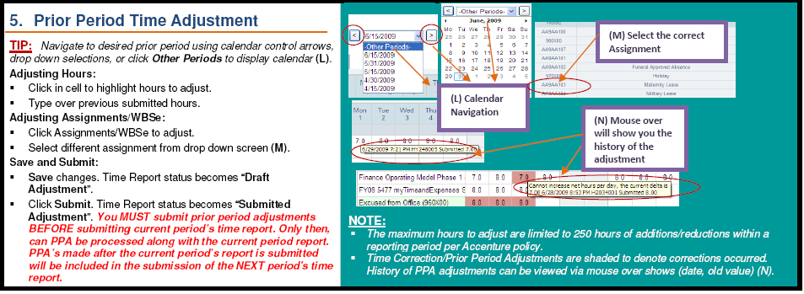
MYTE : My Time & Expenses
Prior Period Adjustments - Time
Copyright © 2017 Accenture All rights reserved.

Slide 38
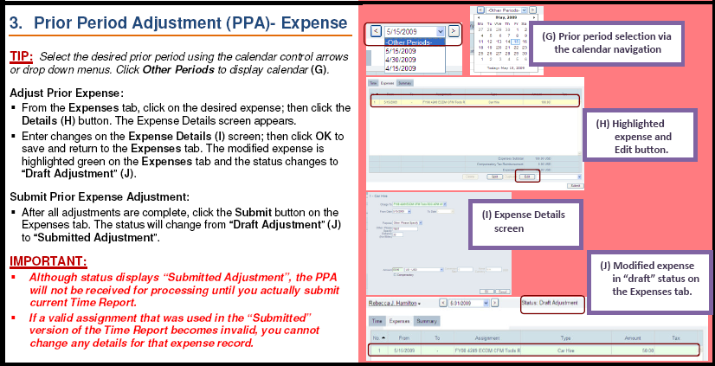
MYTE : My Time & Expenses
Prior Period Adjustments - Expenses
Copyright © 2017 Accenture All rights reserved.

Slide 39
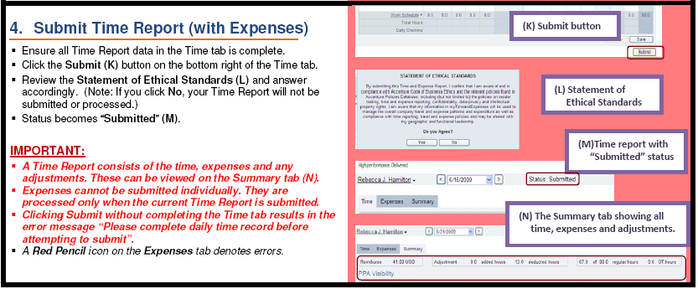
MYTE : My Time & Expenses
Submission of T&E
Copyright © 2017 Accenture All rights reserved.

Slide 40
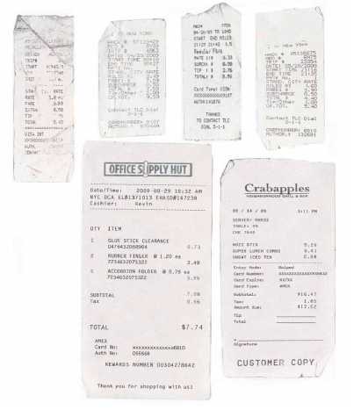
MYTE : My Time & Expenses
Expense Overview
Time and Expenses are submitted at the same time
Expenses must be submitted within one month
You cannot enter expense entries in for a future time period (no forecasting)
Remember to remove per diem type expenses (e.g. room service, dinners, etc.) from hotel receipts prior to entering on expense report; those are covered under per diems
Per Diems should not be charged when at the Q center (all meals are provided)
Expense app available for download via Portal
Copyright © 2017 Accenture All rights reserved.

Slide 41
MYTE : My Time & Expenses
What is my Time Report Status?
Time Report Status | Description
Draft | Time report has been edited but not submitted
Submitted | Time report has been submitted
Processed | Submitted Time Report has been sent to SAP
Draft Adjustment | Time report is being modified after submission (prior period adjustment)
Submitted Adjustment | A prior period adjustment has been made and submitted
Processed Adjustment | A prior period adjustment has been processed.
Copyright © 2017 Accenture All rights reserved.

Slide 42

MYTE : My Time & Expenses
When Do I Get Paid?
Pay periods | Submission day | Pay day
Mid month: 1st - 15th of month | Submission due dates are different depending on country requirement. Follow the link in the myTimeandExpenses Reference: When is My Report Due? | Time and Expense pay day varies among the different countries. Confirm pay days via the link in the myTimeandExpenses Reference to myRequests
Month end: 16th - end of month
Copyright © 2017 Accenture All rights reserved.

Slide 43

Provident Fund Transfer
Requirements
Requirements
In order to transfer your EPF account online from the previous to the current employer:
Both employers need to have their digital signatures registered with EPFO
Both employers need to verify the claim papers online by digitally signing it off
The status of the transfer can be checked through your member portal account
Note: If the employers have not registered their digital signatures online, you will need to take the process offline.
Copyright © 2017 Accenture All rights reserved.

Slide 44
Provident Fund Transfer
Employee Registration
Before applying for the PF Transfer:
Employees should register on the PF Portal – URL for Registration http://memberclaims.epfoservices.in/index.php
Employers should register on the PF Portal along with Digital signatures
Copyright © 2017 Accenture All rights reserved.

Slide 45
Provident Fund Transfer
Online Transfer
Once the registration is a success, follow the below steps:
Using the URL http://memberclaims.epfoservices.in/index.php , go to the home
On the home page under the category “FOR EMPLOYEES”, click the Online Transfer Claim Portal (OTCP) link
http://www.epfindia.com/Employee_OTCP.html page will download. You’ll see the below options
Check Eligibility for filing Online Transfer Claim
Detailed Instructions (On clicking on the “Detailed Instructions”, following options would appear:
o Important guidelines
o Process flow for filing Online Transfer Claim
o Process flow for registration on Member Portal
Copyright © 2017 Accenture All rights reserved.

Slide 46
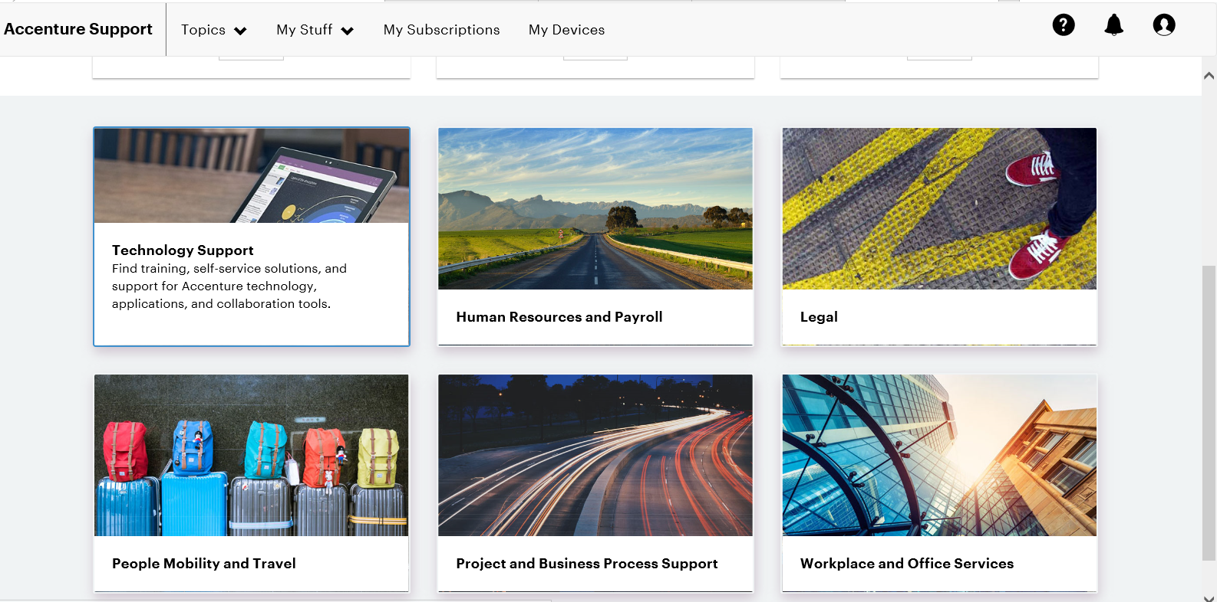
Queries
Service Now
https://accentureinternal.service-now.com/support_portal/

Slide 47
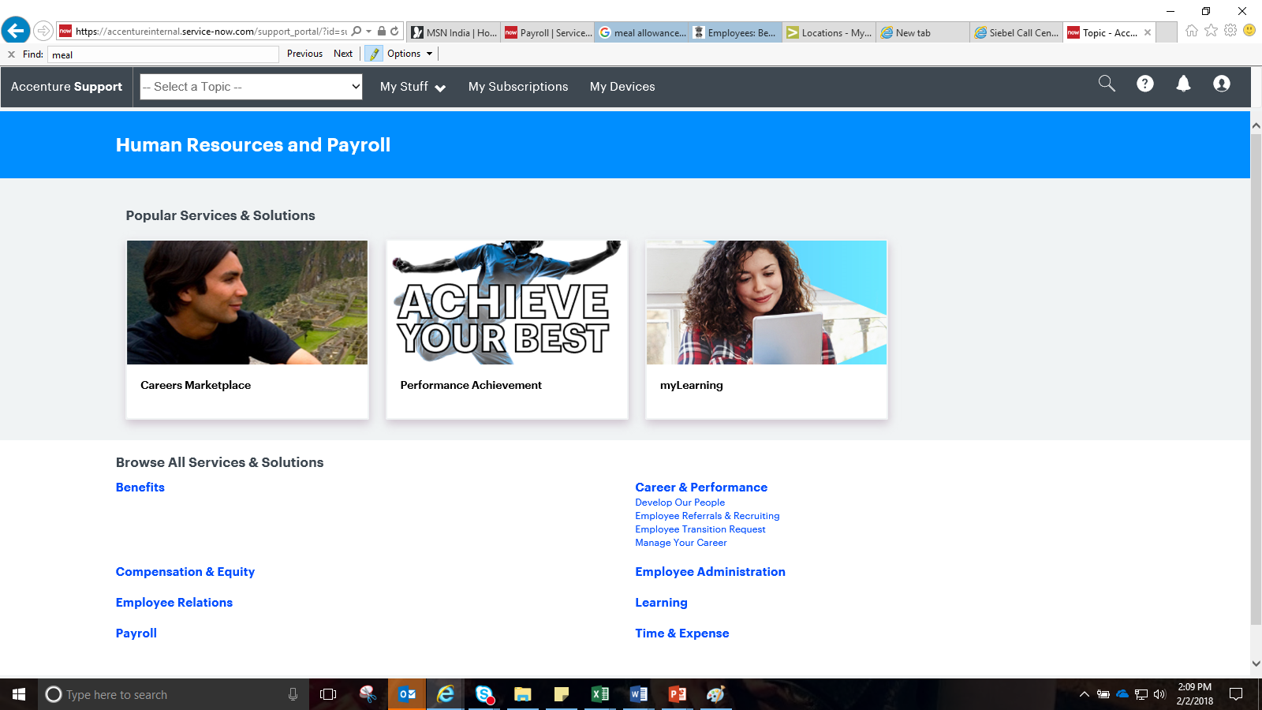
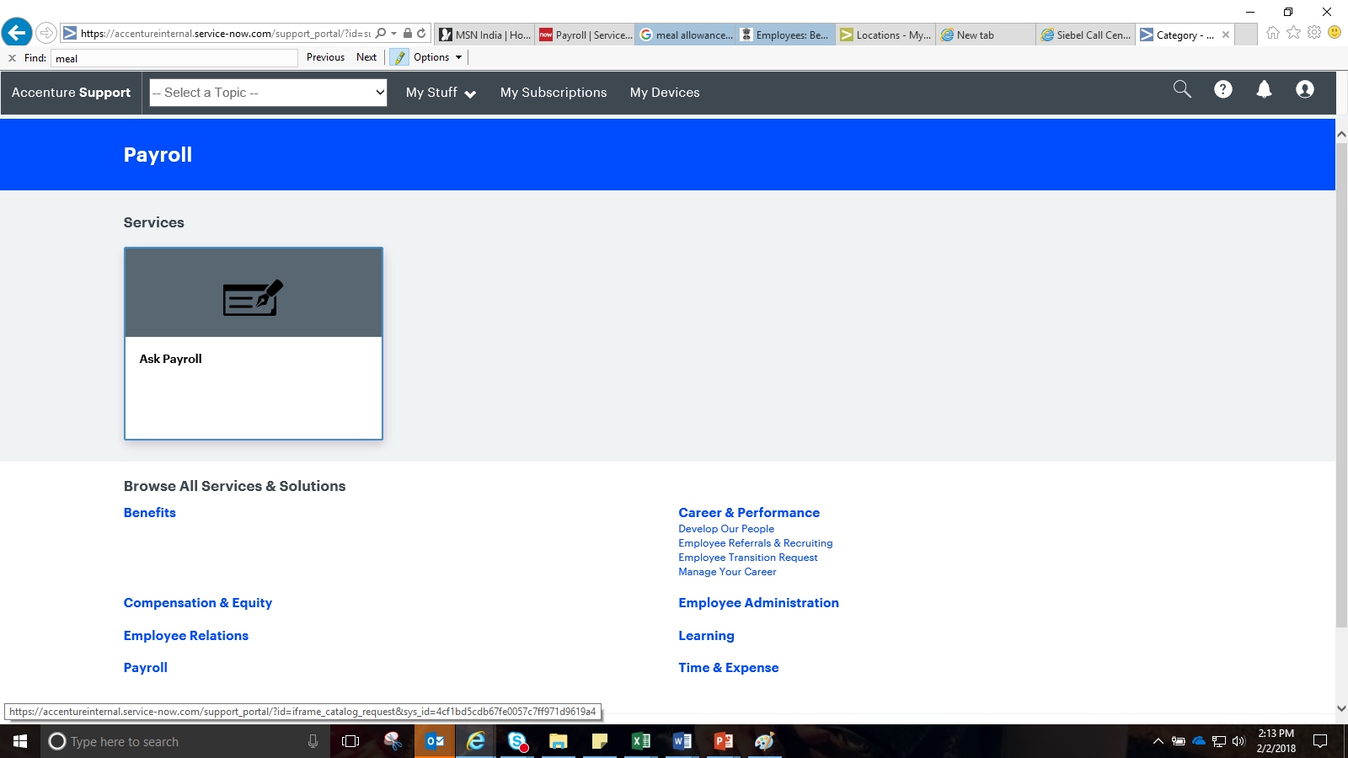
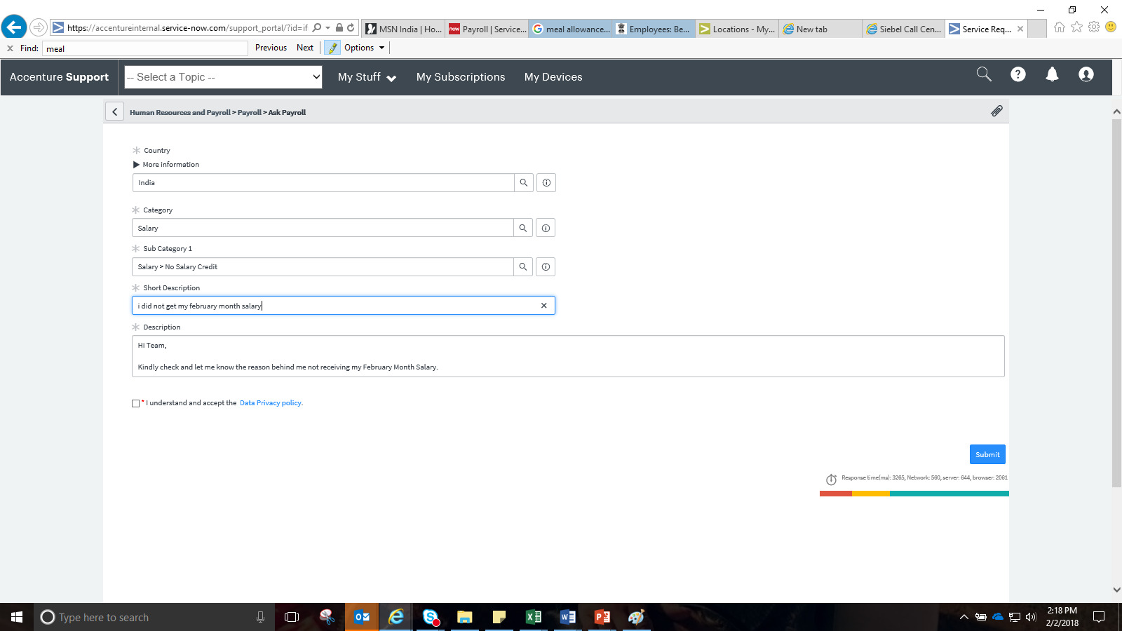

Slide 48
THANK YOU
Copyright © 2017 Accenture All rights reserved.

